Slide 1

Company Profile

Slide 2
Company Profile Index
About Temp Holdings (Our group)
Group organization
Global ranking
Business in Asia
About Intelligence Business Solutions (IBS)
Company organization
Sales portfolio
Our strength and products
Global Team Software Development Model
What is "Global Team Model”
Our global team
Future plan

Slide 3





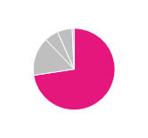
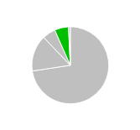
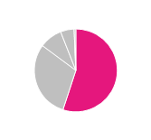
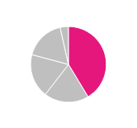
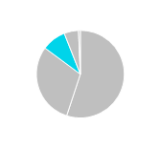
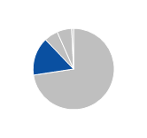
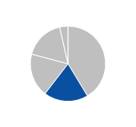
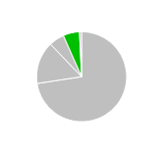
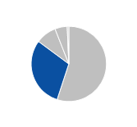
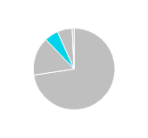
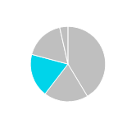
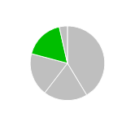
Ⅰ. About Temp Holdings 1. Group organization
Founded in1973 and listed in 1st section of TSE from 2006
Revenue: USD 3,234m EBITDA: USD 238m
# of employees: 14,265
Business Segment | 2014 Actual (USD) |  | # of Employees
 | Revenue | EBITDA |  | Services | Brands | Highlights
 | 2,387 | 124 | 5,898 | Temporary staffing Business process outsourcing Payroll
 | 502 | 68 | 2,724 | Permanent placement Job portal Perm Part time job
 | 181 | 20 | 2,668 | IT consulting System/ software development IT outsourcing |  | Strong business relationship with Japanese Telecom. companies
 | 193 | 12 | 2,471 | R&D outsourcing Design Development Testing |  | Strong business relationship with Nissan/ Volvo and Panasonic
Temporary Staffing & BPO
No.1
market share
in Japan
55%
41%
73%
Recruiting
No.2
market share
in Japan
15%
30%
19%
ITO
6%
9%
19%
Engineering
6%
5%
17%

Slide 4
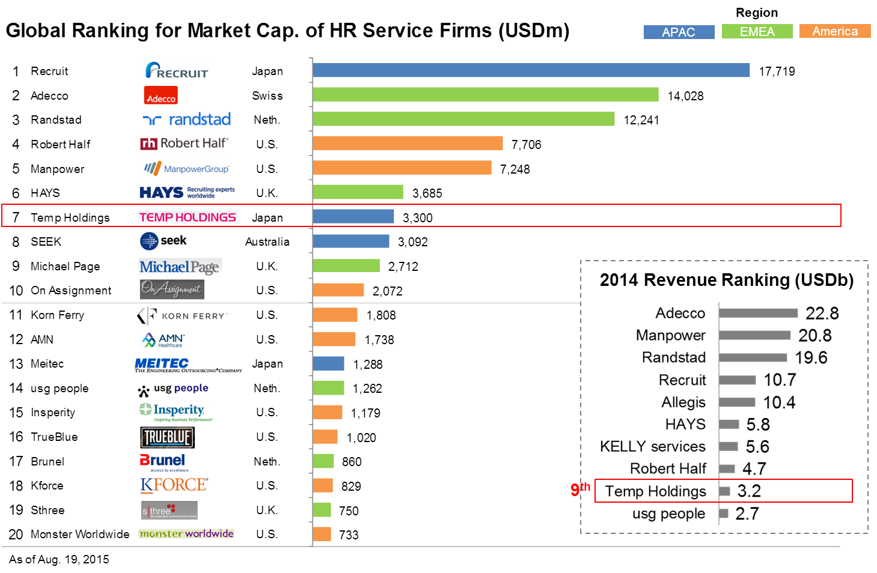
Ⅰ. About Temp Holdings 2. Global ranking

Slide 5
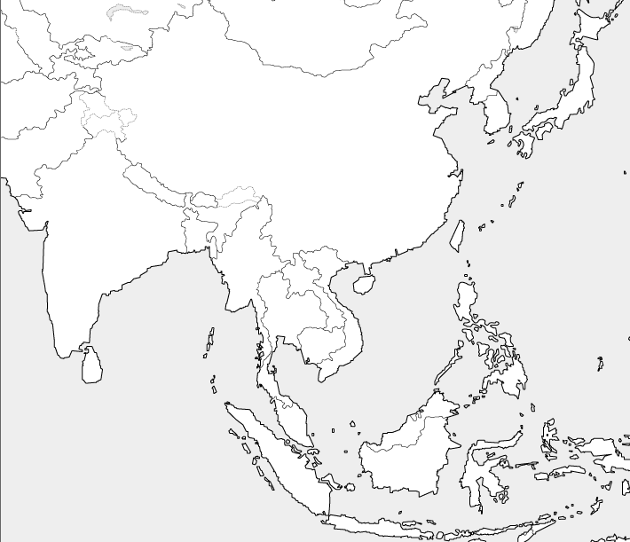
Ⅰ. About Temp Holdings 3. Business in Asia
Temp Group (including Kelly in North Asia) and Intelligence currently have presence in 7 nations (Singapore, Indonesia, Vietnam, Malaysia, China / Hong Kong, Taiwan, and Korea) around 40 branches.
Locations of Temp Group in Asia
Kelly（North Asia）
Intelligence
North Asia
Around 450 employees
China
Hong Kong
Taiwan
Korea
North Asia
South Asia
Around 290 employees
Singapore
Indonesia
Vietnam
Malaysia
South Asia

Slide 6
Company Profile Index
About Temp Holdings (Our group)
Group organization
Global ranking
Business in Asia
About Intelligence Business Solutions (IBS)
Company organization
Sales portfolio
Our strength and products
Global Team Software Development Model
What is "Global Team Model”
Our global team
Future plan

Slide 7
Ⅱ. About IBS 1. Company organization
Founded in 2001
8 offices in japan and 1 office in Vietnam
# of employees: 2700
Business
Segment
# of
Employees
Services
Client industry
System integration
800
Cloud integration
(e.g. AWS,SFDC and MS-Azure)
Application service
Legacy-Migration
talent management
(It helps HR team ,update employee’s record)
Global team model(Vietnam and Japan)
Recruitment agency (e.g. Tempstaff/Intelligence)
Retailer (e.g. AEON)
Banking
IT Outsourcing
1,300
System management
data center management
NW management
Telecom (NTT, KDDI, Softbank)
Sales marketing
600
Marketing automation (oracle ,marketo…)
Call center (400 seats)
Web analytics
(Google analytics , adobe analytics)
Sales outsourcing
Telecom
Real estate (e.g. Mitsui)
Internet service
Consulting
60
For employee/client Survey/ Evaluation sheets
Employee assessment
Training
Telecom
Recruitment agency

Slide 8
Ⅱ. About IBS 2. Sales portfolio
IBS is growing up fast. We have stable IT out sourcing business, strategic system integration business and big growing sales marketing solutions.
2013
2014
2015
202
Million USD
152
Million USD
Sales
Marketing
14％
118
Million USD
Sales
marketing
16％
System
integration
45％
System
Integration
30％
System
Integration
31％
IT Out sourcing
67％
IT Out sourcing
49％
IT Out sourcing
35％

Slide 9


Ⅱ. About IBS 3. Our strength and products
Our parent group company is recruitment and temporally staffing agency. To effectively use group company relationship. Then provide our original products to client.
Products
Strength
# of client
Highlights
220
companies
No.2
Market
share
in Japan
Culture
Fresh (Young)
Highly innovative
Part time staff recruitment Ad and candidate management service for retailer, restaurant, shop etc.…
Group
Large recruitment database
Large client network (specialize in telecom media and HR)
Strong Financial Capability
HITO-Talent
3
Big enterprise
Advanced UI/UX.
Advanced enterprise talent management system (manage employees evaluation, skill, history)
Solution
800 Software developers
QA team and unified process
Advanced Technology (e.g. AWS big data solution)
1,200
shops
No.1
Market
share
in Japan
Best price mobile cloud POS system for restaurant and shop

Slide 10
Company Profile Index
About Temp Holdings (Our group)
Group organization
Global ranking
Business in Asia
About Intelligence Business Solutions (IBS)
Company organization
Sales portfolio
Our strength and products
Global Team Software Development Model
What is "Global Team Model”
Our global team
Future plan

Slide 11

Ⅲ. Global Team Software Development Model 1. What is "Global Team Model”
In Global Team, we communicate in English and high speed network communication tools. Therefore we don’t have to care place of work in the world.
As usual offshore model
Global Team Model
Client
Client
English communication
PM
Design
（Japan）
PM
SE
SE
SE
SE
SE
E-mail
DVD media
Japanese
translation
（Philippines）
（Japan）
BSE
（Vietnam）
Coding
（Vietnam）
SE
SE
SE
SE
SE
SE
（Indonesia）
Network Communication tools
Divided team and role, process
Limited communication way
Don’t divide team
Unlimited communication in English

Slide 12
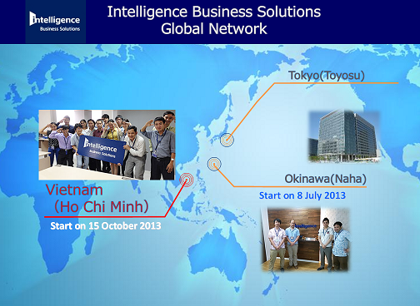
Ⅲ. Global Team Software Development Model 2. Our global team
In the near future, software development industry will be change significant in the world. But we can’t foresee exactly future. IBS is still domestic company. We should to be change faster to adapt the new world. Therefore we started to united with South East Asian country’s IT engineers.
IBS global team (2015)
Offices
Roles
IBS
Tokyo
Communication with client in Japanese
Client requirement development and business design
IBS
Okinawa
Global team project management
Standardization of system development in IBS global
IBS
Vietnam
Development high quality IT systems
Make succeed and expand another Asian country

Slide 13
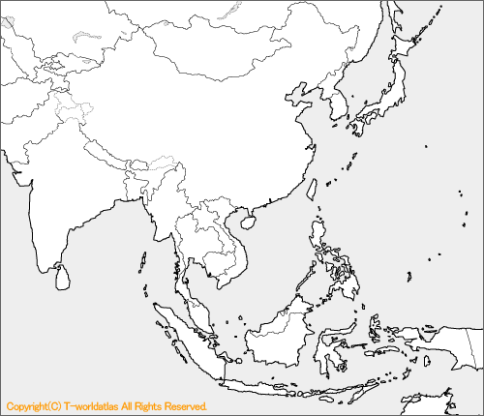
Ⅲ. Global Team Software Development Model 3. Future plan
In 5 years, we want to have 5 offices in Asia. There are some potential city in South East Asia. Especially Manila and Jakarta we are having strong interesting.
IBS global team (2020 assumption)
Dhaka
Tokyo
Yangon
Okinawa
Bangalore
Manila
Jakarta
Ho Chi Minh

Slide 14
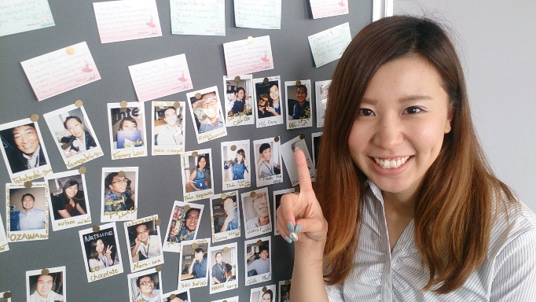
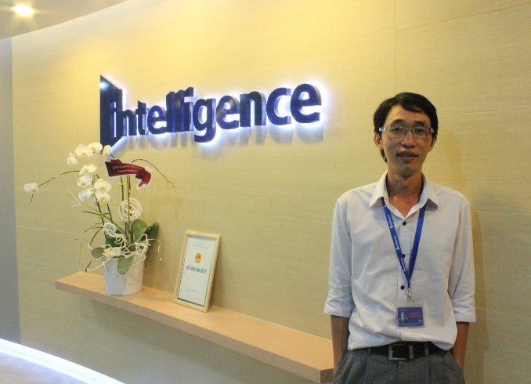

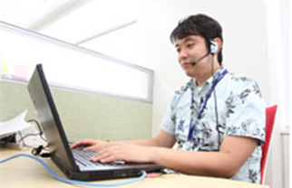
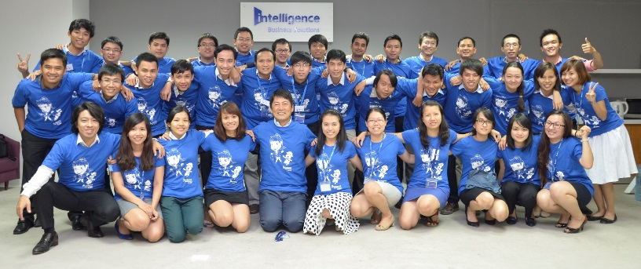
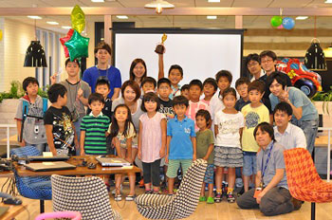

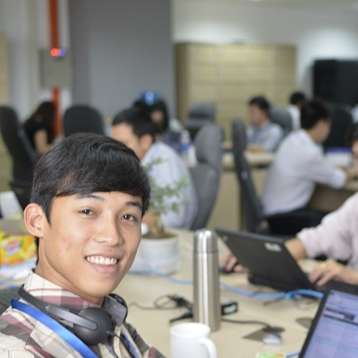
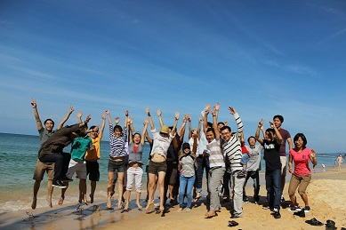
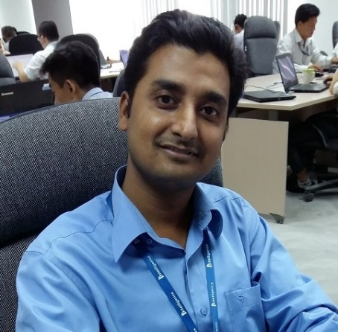
Thank you very much for taking your time !

